Slide 1

Netflix Stock Analysis
Todd Frazer

Slide 2
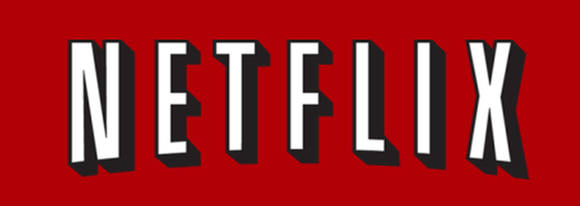
Objective:
Netflix is a popular streaming service that started in 1997 sending dvds to customer's homes; They would later in 2007 become the first large streaming service available to customers across the globe.
This project's objective is to analyze Netflix's stock price and volume from the earliest data we can gather to the present.

Slide 3
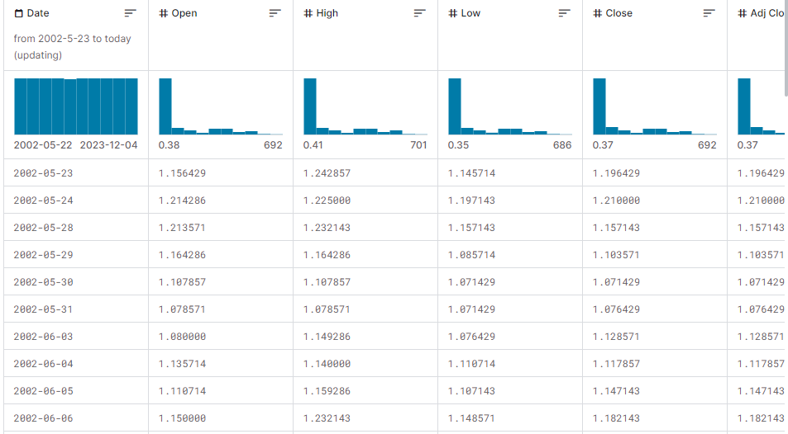
Data Collection Kaggle:
This is data from 2002-Present Netflix Stock Data. It shows High, Low, Open, Close, Dates, and more.

Slide 4
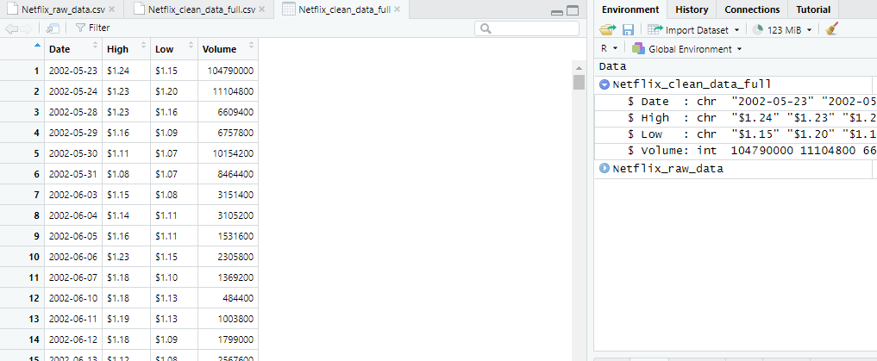
Cleaning the Data R/Google Sheets:

Slide 5
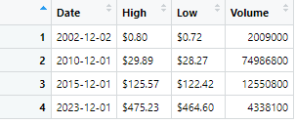
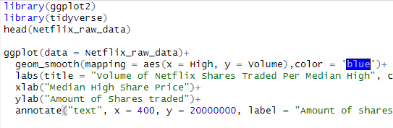
Analysis of Clean Data: R
Top left: Filtered Data max and min 2002- Present
Bottom left: We have a graph code to view this specific data in visualization form using ggplot2 in R.

Slide 6
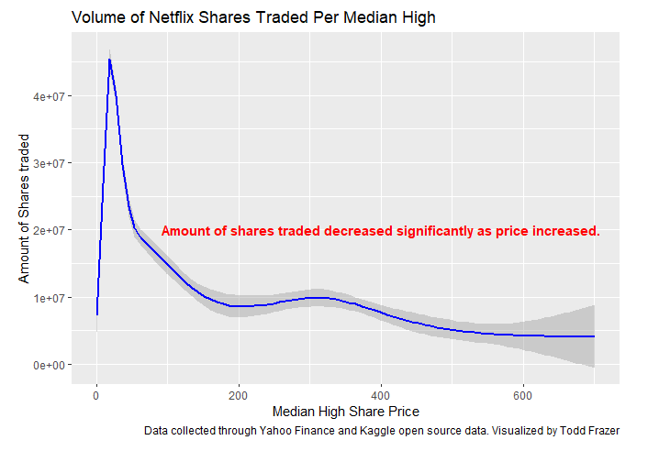
Visualization: R
To the left: This graph shows the amount of traded shares compared to the median high share price.
We can see the amount traded significantly falls as soon as the share price reaches greater than about $100/share. (that's nearly 12 million active trades dropping down to nearly 4 million active trades.

Slide 7
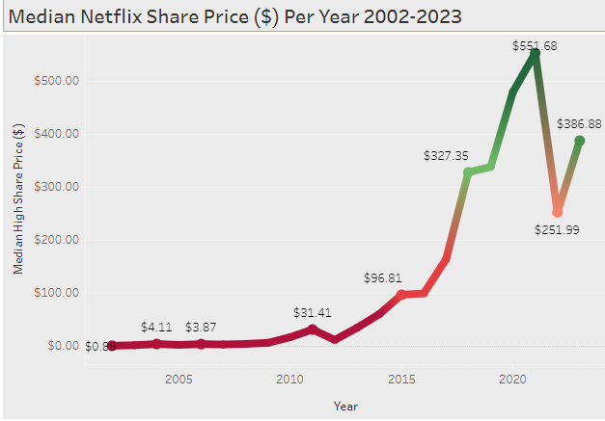
Interactive Dashboard: Tableau
Left: Using Tableau visualization software we are able to create an interactive dashboard that shows The median high share price per year.
Link below:
https://public.tableau.com/views/NetflixMedianSharePrice2002-2023/Dashboard1?:language=en-US&:display_count=n&:origin=viz_share_link

Slide 8
Conclusion and Findings:
Netflix share price has increased from $0.89 in 2002, to $551 in 2021.
In 2022 share price decreases over 50%
Netflix currently at $386 per share
From 2008 to 2010 the volume traded skyrockets 2.8million to 7.5 million

Slide 9
Sources:
Cite
[1] Yahoo Finance - $NFLX - Historial Data 2002 - 2023 (https://finance.yahoo.com/quote/NFLX/history?p=NFLX)
[2] Kaggle- Netflix Stock price- Henry Shan - 2023 (https://www.kaggle.com/datasets/henryshan/netflix-stock-price)

